Slide 1

Health Assistant Using Machine Learning
HALDIA INSTITUTE OF TECHNOLOGY
Dept : INFORMATION TECHNOLOGY
Submitted To :- Mr. Debasish Sahoo
Submitted By :--
Name | Roll No | Email
Subhadip Dey | 10300223170 | deysubhadip66@gmail.com
Srijani Dinda | 10300223169 | srijanidinda64@gmail.com
Sathi Pramanik | 10300223137 | 18sathipramanik@gmail.com

Slide 2
Introduction
In today’s rapidly evolving healthcare environment, hospitals generate a massive volume of patient data on a daily basis. This data includes medical history, laboratory test results, vital signs, lifestyle factors, and treatment records. Managing and analyzing such large and complex datasets manually is not only time-consuming but also highly prone to human error.
Machine Learning (ML) provides an effective solution by enabling automated analysis of healthcare data to uncover hidden patterns, trends, and relationships. By leveraging ML techniques, healthcare systems can assist doctors in early disease detection, accurate diagnosis, personalized treatment planning, and risk assessment. This data-driven approach enhances clinical decision-making, reduces workload on medical professionals, and improves overall patient care and operational efficiency.

Slide 3
Problem Statement
Doctors and healthcare staff are required to make quick and critical decisions based on multiple patient parameters such as age, vitals, medical history, and lifestyle factors.
Manual analysis of patient records is time-consuming and may not always provide accurate or timely insights, especially when dealing with large volumes of data.
Predicting disease conditions, recovery duration, treatment cost, and readmission risk becomes challenging due to the complexity and size of healthcare datasets.
The lack of automated data analysis can lead to delayed diagnosis, inefficient treatment planning, and increased workload for healthcare professionals.

Slide 4
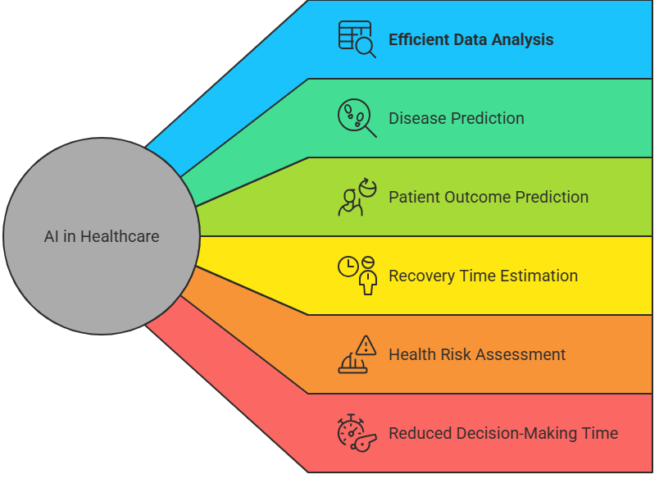
Objectives

Slide 5
Dataset Overview
Total Records: 10,000 patient records, representing a large and diverse sample suitable for reliable statistical analysis and machine learning model training.
Total Attributes: 28 features covering patient demographics, physical measurements, health indicators, hospital operations, financial information, and medical outcomes.
Data Types: A combination of numerical data (such as age, vital signs, hospital stay duration, and treatment cost) and categorical data (such as gender, disease type, lifestyle habits, insurance status, and treatment outcomes).
Data Nature: The dataset simulates a real-world hospital environment, reflecting practical healthcare scenarios and patient variability.
Use Cases: Designed for healthcare analytics, including disease prediction, treatment cost estimation, patient outcome analysis, and hospital readmission risk assessment using machine learning techniques.

Slide 6







Dataset Attributes
Patient Demographic Details
Patient_ID , Patient_Name , Age , Gender , City
Physical Details
Height_cm , Weight_kg
Health Metrics
Pulse_Rate , Oxygen_Level ,BP ,
Sugar ,Chol
Lifestyle & Risk Factors
Smoke, Alcohol , Stress_Level ,
Chronic_Disease
Hospital & Treatment Details
Doctor_Specialization, Appointment_Type, Admit_Type, ICU_Required, Days, Visits
Medical Outcomes
Disease , Outcome, Readmitted, Status
Financial Information
Cost , Insurance

Slide 7
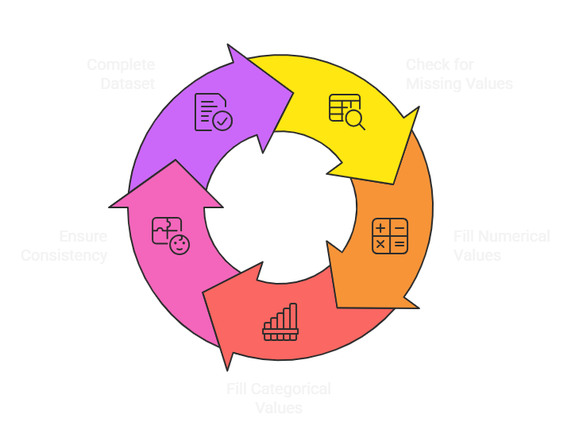
Data Preprocessing

Slide 8
Feature Selection
To improve model accuracy and reduce complexity, the most relevant health-related features were selected based on correlation analysis and domain knowledge.
Selected Features
Age – Influences disease risk and treatment cost
Height (cm) – Used for physical assessment and BMI calculation
Weight (kg) – Indicates body condition and health risk
Blood Pressure (BP) – Key indicator of cardiovascular health
Sugar Level – Important for diabetes and metabolic conditions
Cholesterol Level – Associated with heart disease risk
Days in Hospital – Reflects severity of illness and treatment duration
Number of Visits – Indicates frequency of medical attention required
Treatment Cost – Primary target variable for prediction

Slide 9


Machine Learning Models Used
Classification Models
Random Forest Classifier
  Ensemble-based model using multiple decision trees
  Handles complex relationships and reduces overfitting
  Provides high accuracy and feature importance
K-Nearest Neighbors (KNN)
  Distance-based algorithm
  Classifies patients based on similarity to nearby data points
  Useful for pattern recognition in patient health profiles
Logistic Regression
Simple and interpretable linear classification model
Effective for binary outcomes such as Recovered / Not Recovered
Works well with well-selected features
Regression Model
Random Forest Regressor
Predicts the number of days required for patient recovery
Captures non-linear relationships between health parameters
Robust to noise and performs well on real-world healthcare data

Slide 10
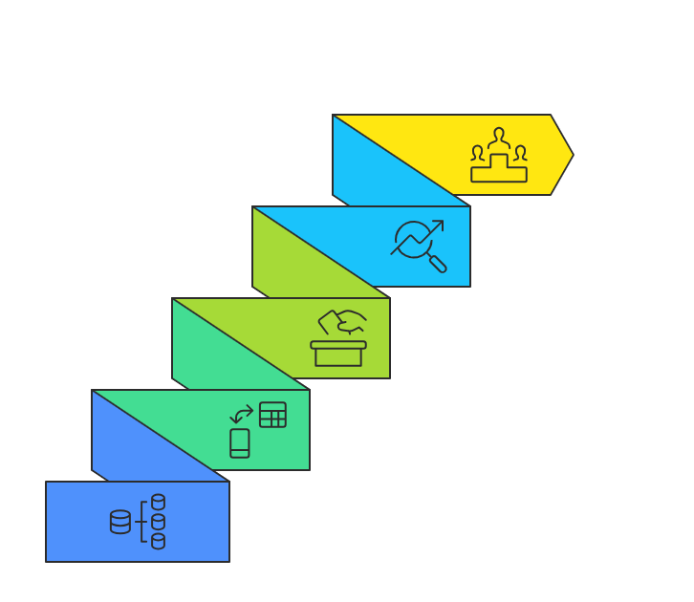
Disease Prediction
Machine learning models analyze patient vitals, lifestyle, and medical history to predict diseases accurately.
Automated prediction reduces manual effort and supports faster clinical decision-making.
Data-driven disease prediction improves diagnosis accuracy and overall patient outcomes.
Early disease prediction helps doctors take timely preventive and treatment actions.
Top 3 disease prediction identifies the most probable diseases for a patient based on risk factors.

Slide 11
Health Risk Assessment
Health risk calculated using:
Blood Pressure
Sugar level
Cholesterol
Age
Risk categories:
Low Risk
Medium Risk
High Risk
Helps in early warning of critical patients

Slide 12
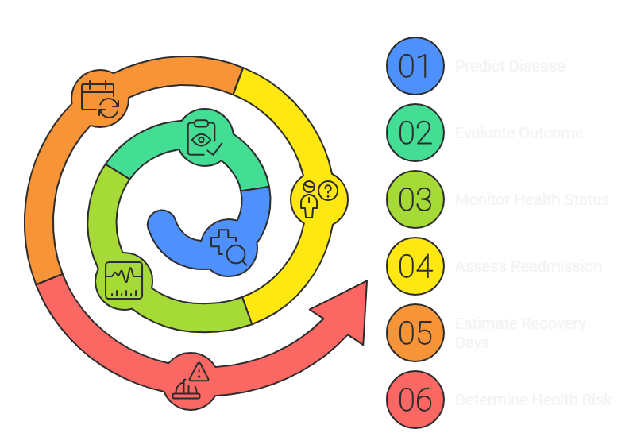
System Output

Slide 13
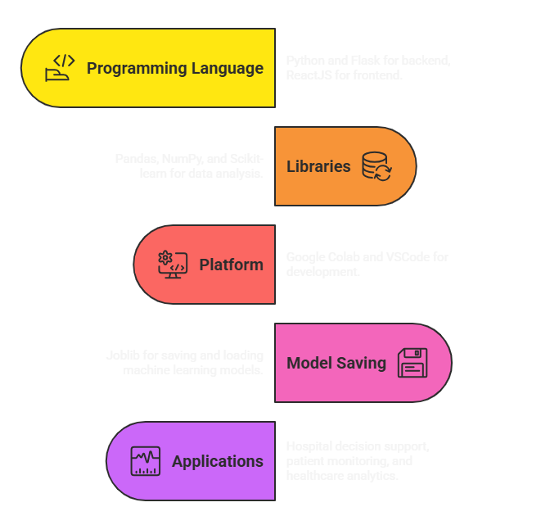
Tools & Applications

Slide 14
Conclusion & Future Scope
Successfully developed ML-based Health Assistant
Demonstrates practical ML application in healthcare
Provides valuable health insights
Can support medical professionals effectively
Future Scope:
Use real-time hospital data
Improve accuracy with advanced ML
Web or mobile application integration

Slide 15
THANK YOU

